Slide 1
Stability Setup Update
11/21/2024

Slide 2
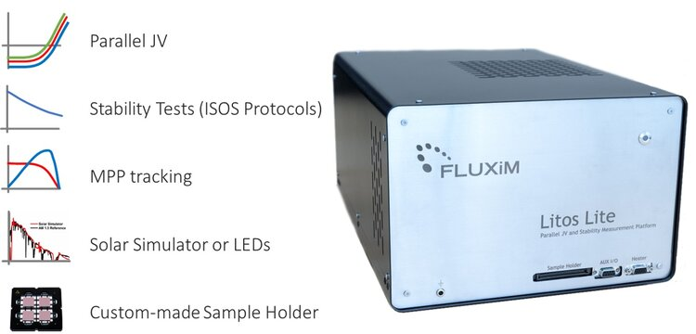
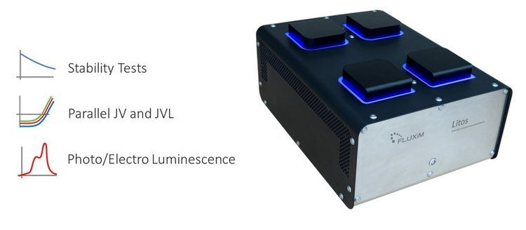
Purpose
To produce results comparable to the Litos/Litos Lite, but at a price that is magnitudes cheaper.
To enable parallel 500-hour stability testing of 8 - 32 devices.

Slide 3
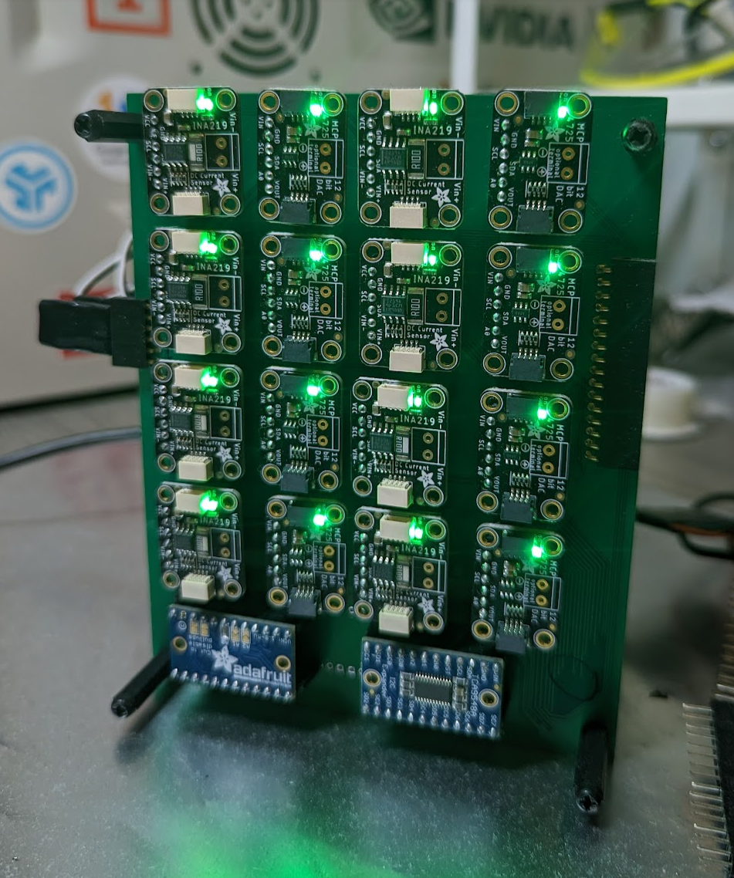
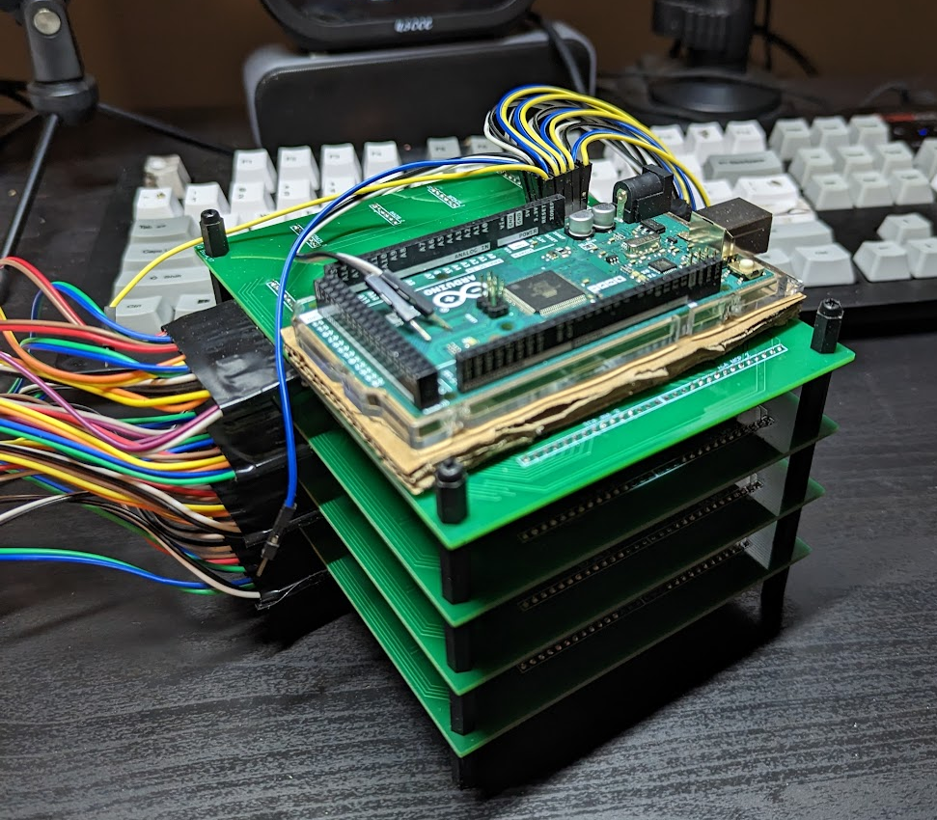
Progress so far
4 Device Parallel JV and MPPT measurement
Costs ~$800 to produce
~5% error for MPPT measurement comparing to Litos Lite
This result was prior only achieved on the hand soldered version
Now the PCB version is achieving this accuracy as well

Slide 4
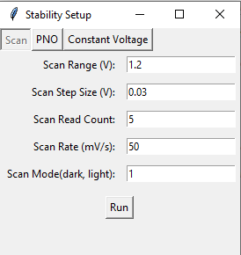
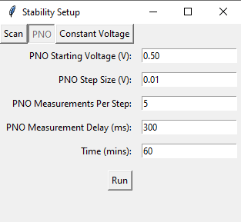
Software
Run .\Stability-Setup_Python\main_2_0.py
Data is output to .\data in a folder with the date
Graphs are automatically generated on trial finish

Slide 5
Software

Slide 6
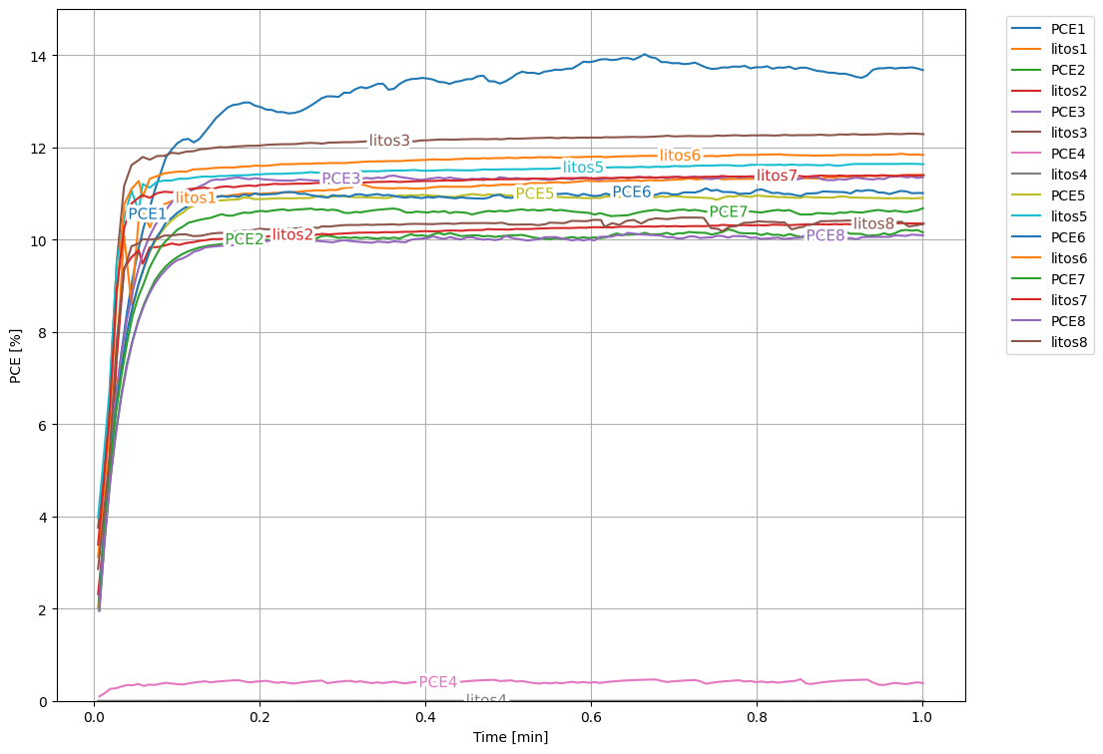
Trial 1
1 minute trial using wavelabs light source
1 Device
N2 flow
Error
Calculated using last 30 second average
Excluding Pixel 1 and 4
5.26%

Slide 7
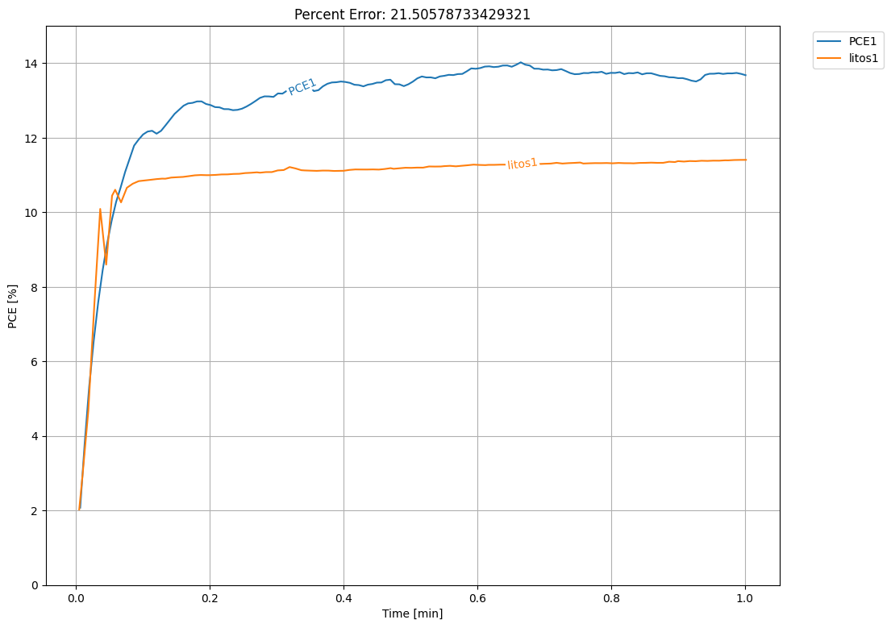
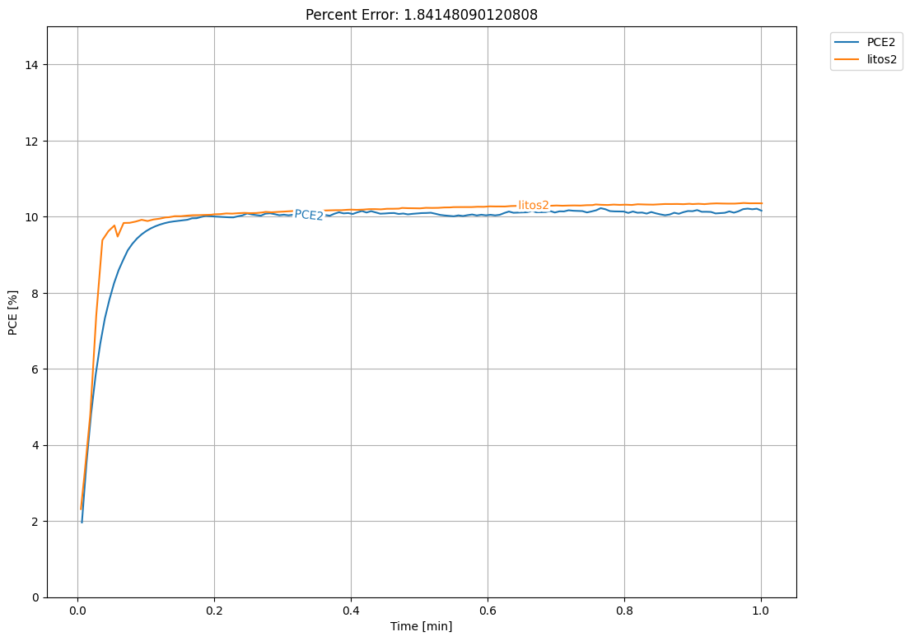
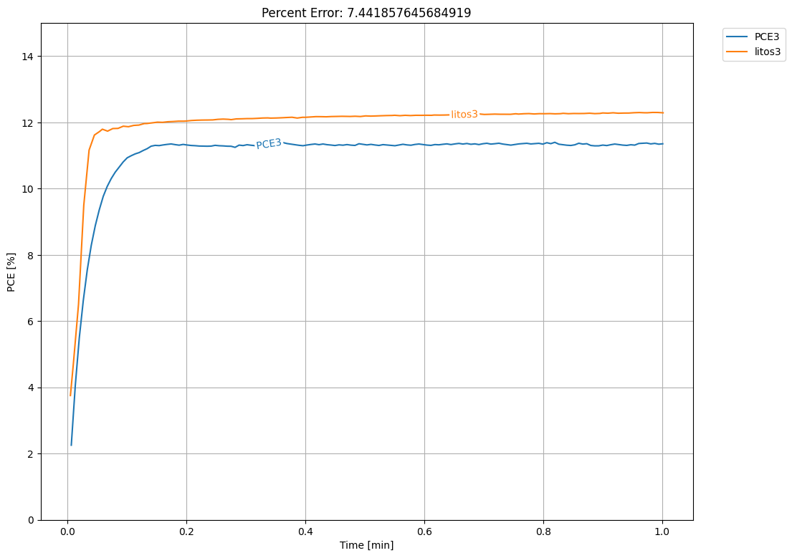
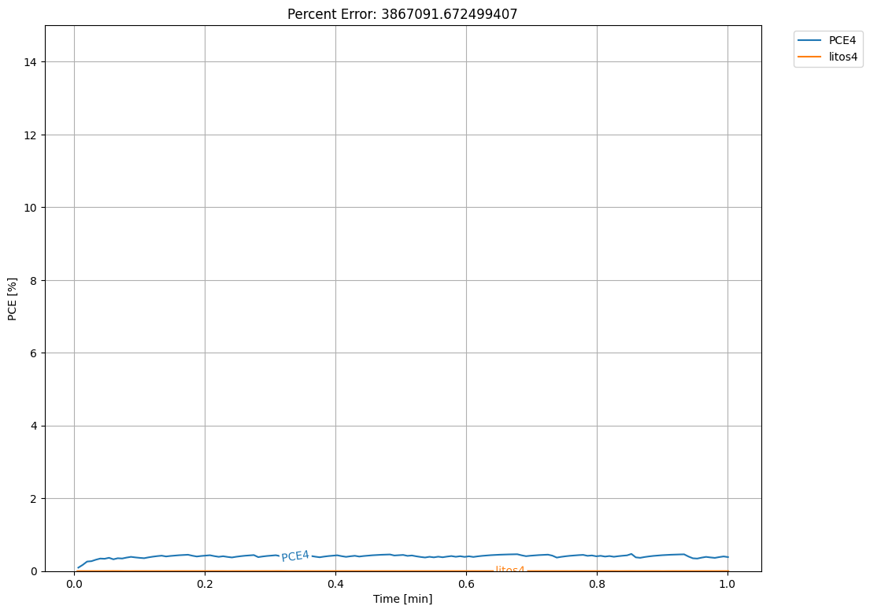

Slide 8
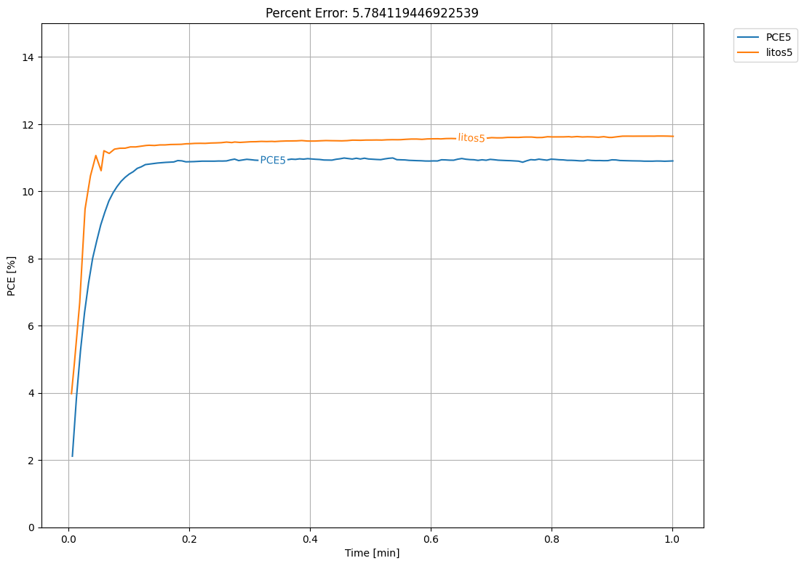
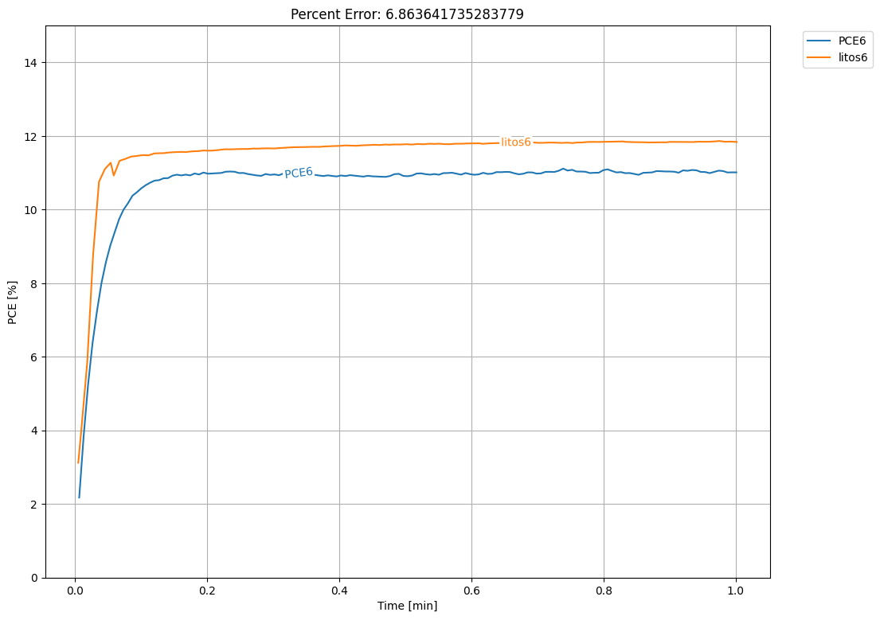
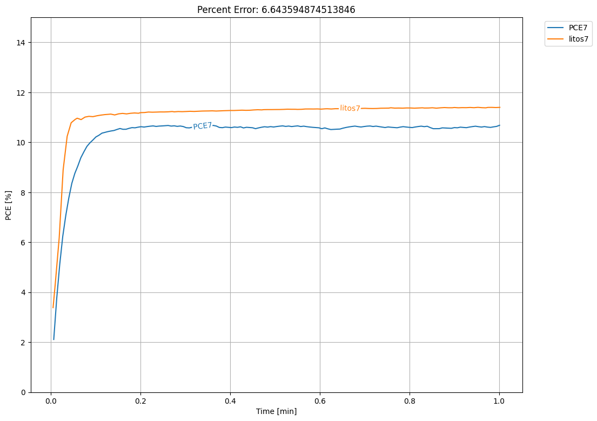
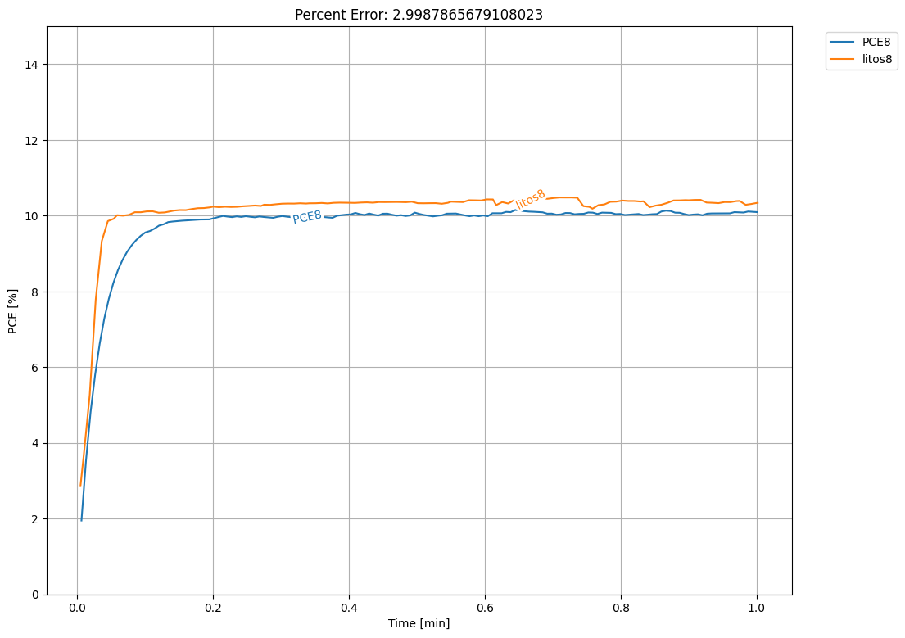

Slide 9
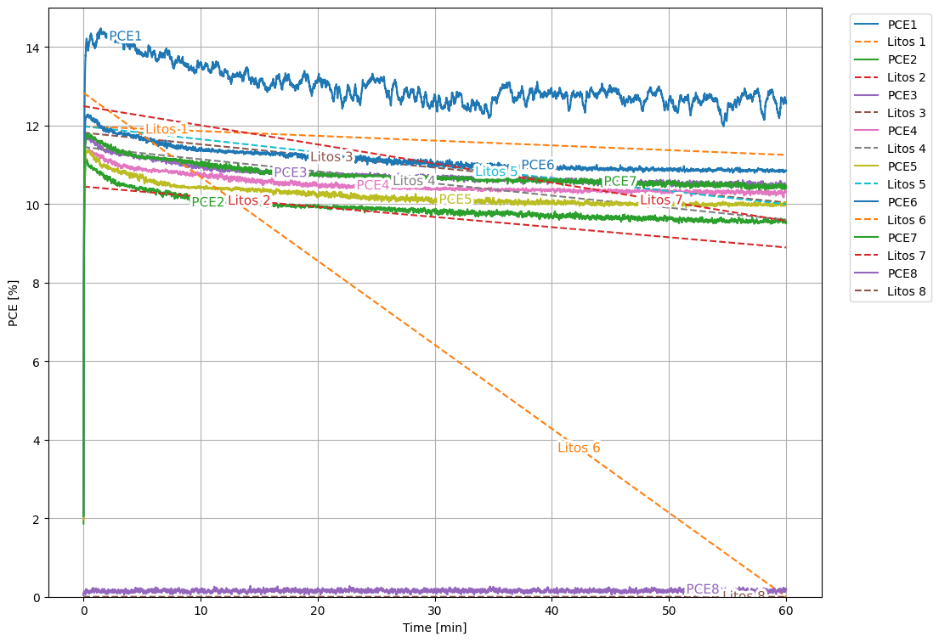
Trial 2
1 hour trial using wavelabs light source
1 Device
N2 flow
Litos Lite measurement at beginning and end of trial
Error
Calculated using last 30 second average
Excluding Pixel 1, 6, 8
5.70%

Slide 10
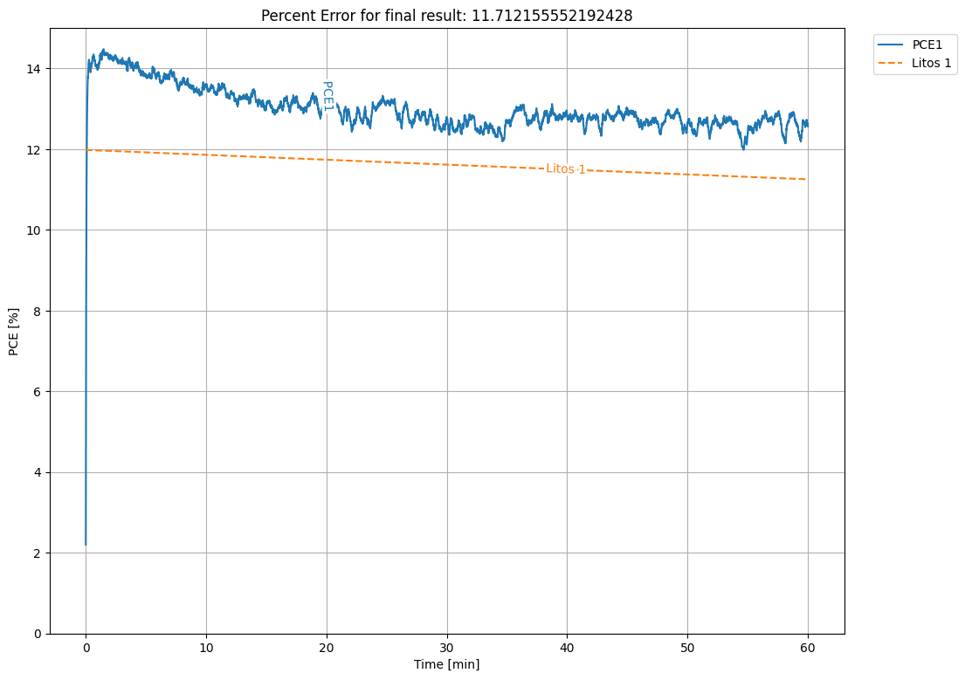
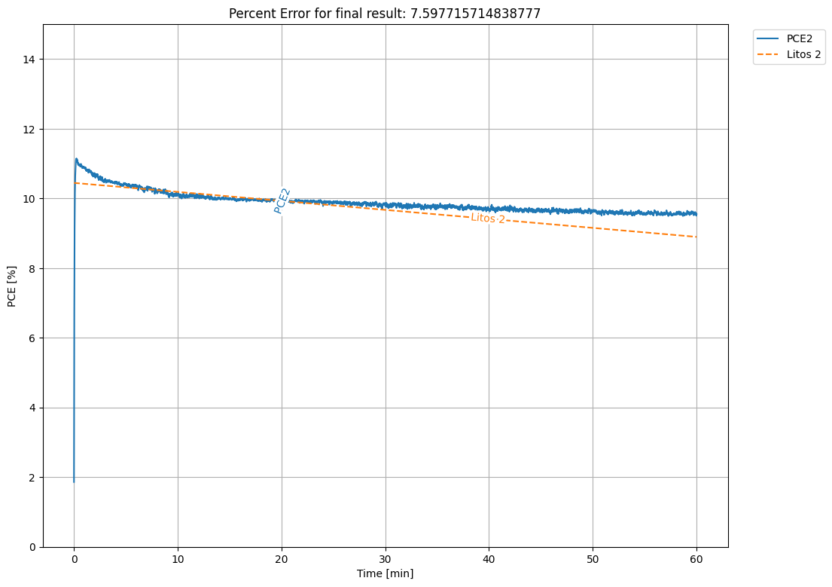
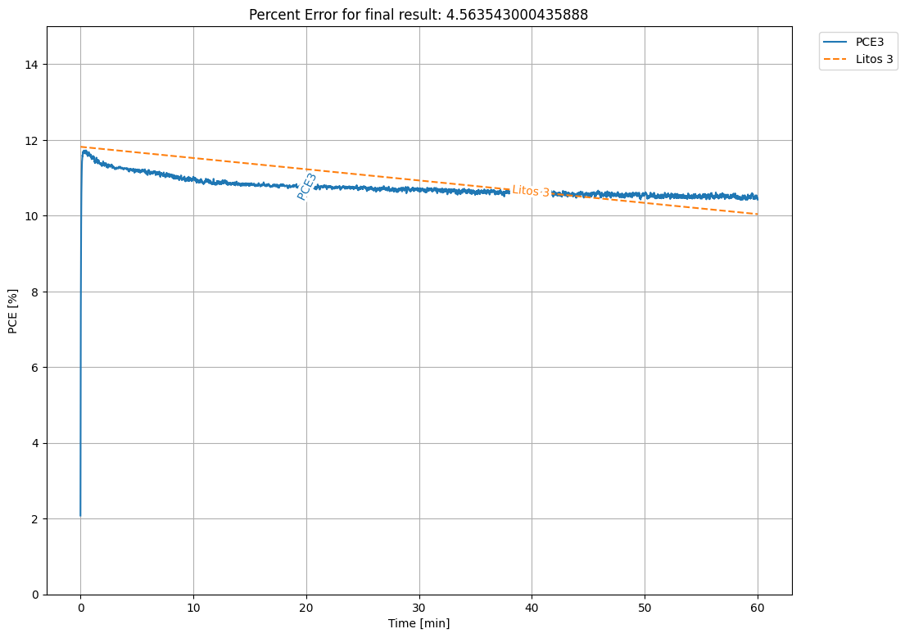
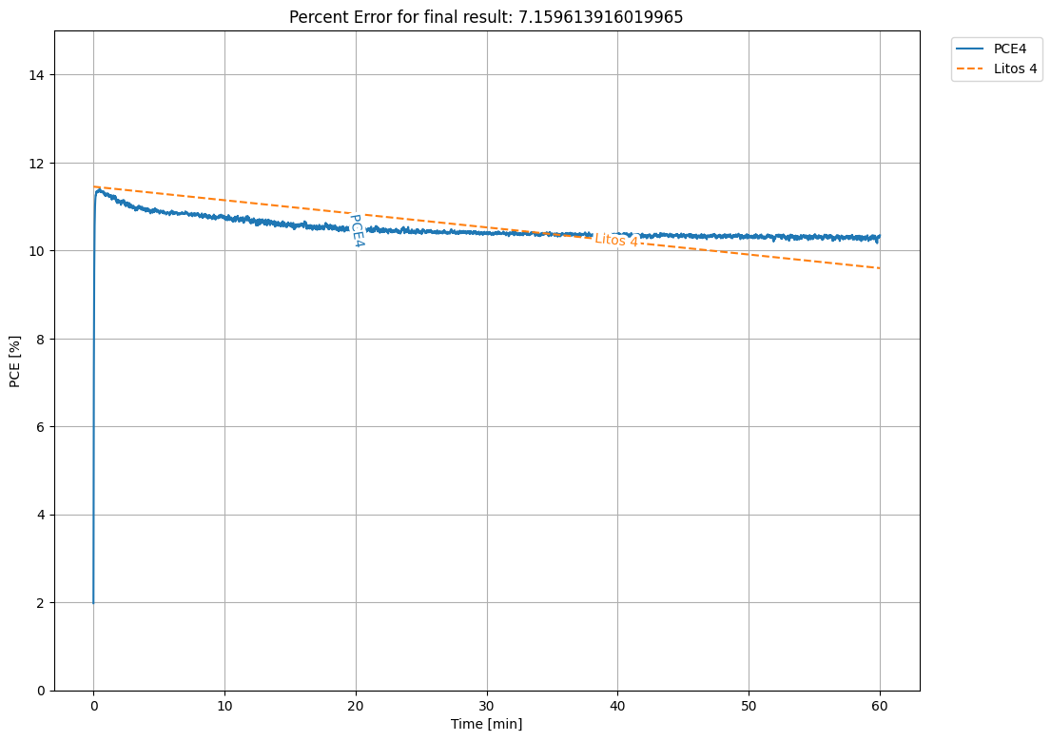

Slide 11
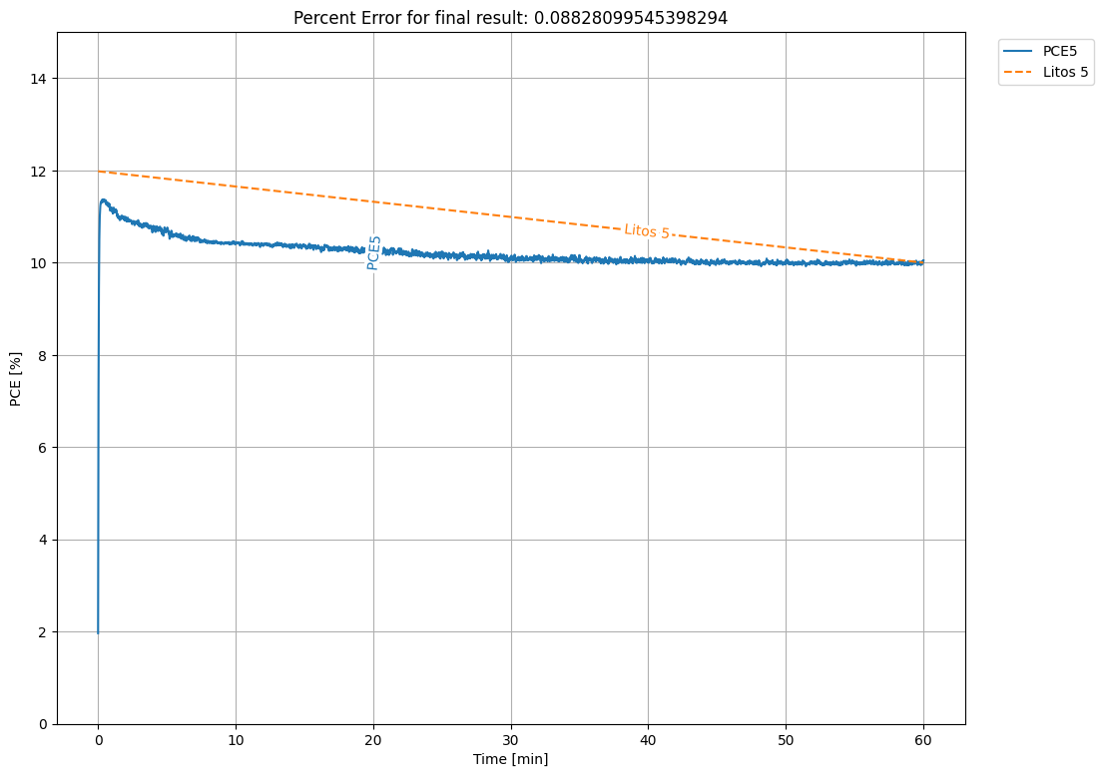
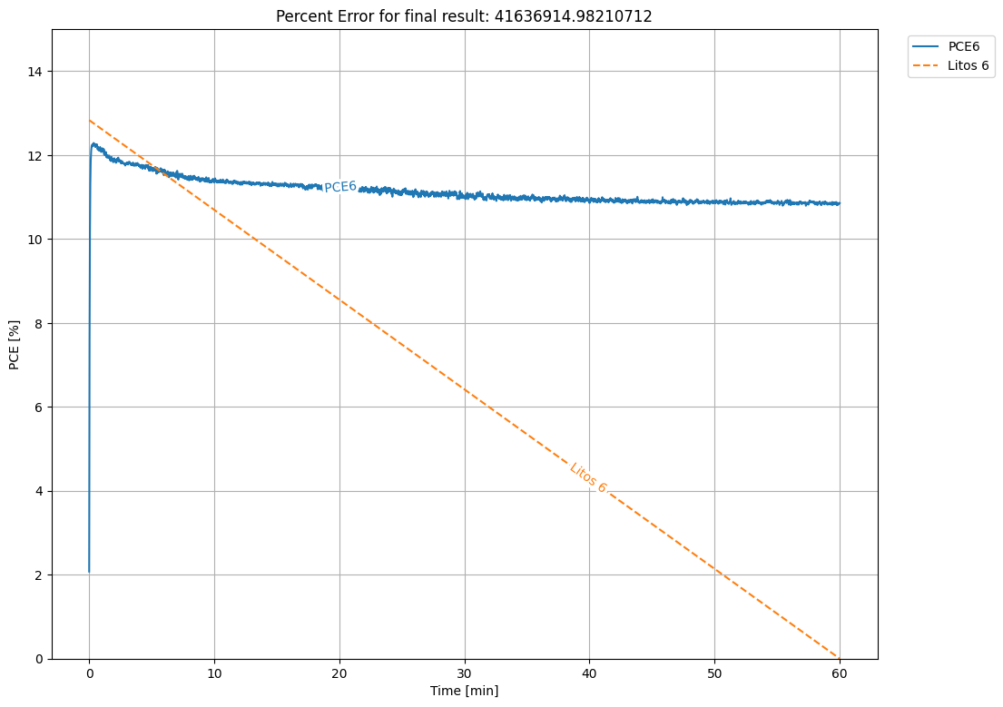
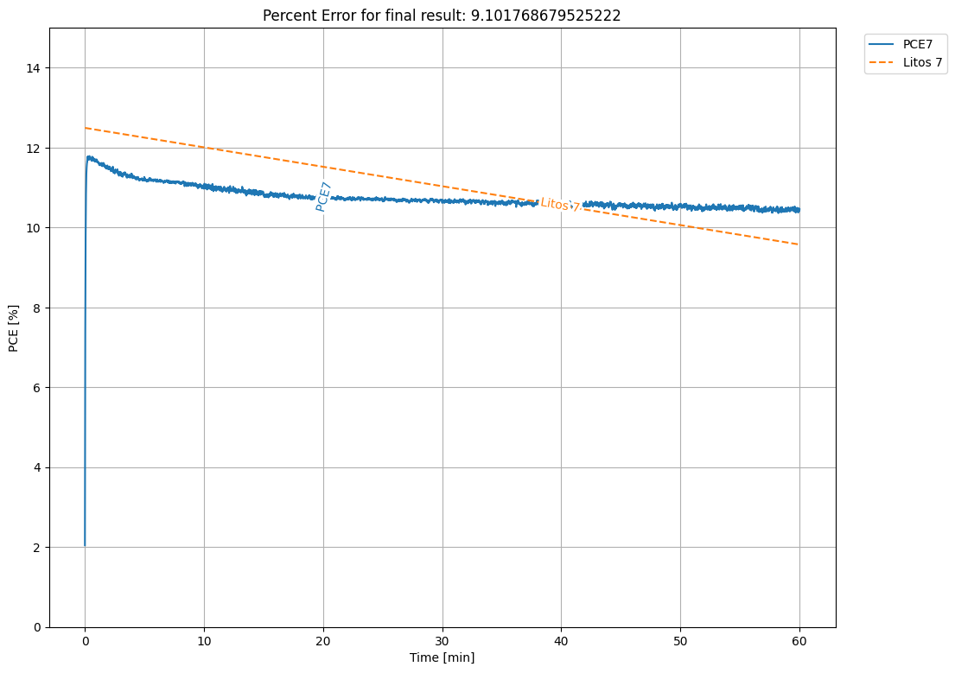
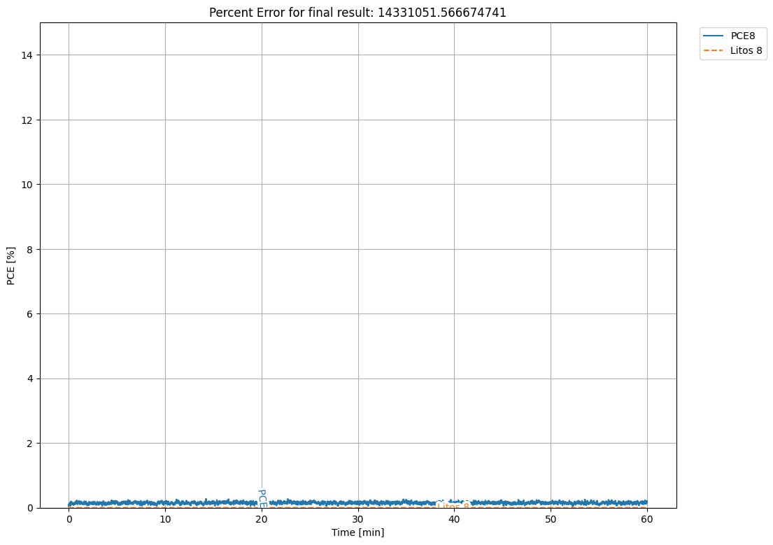

Slide 12
Trial 3
Overnight test using grow light
4 Devices Parallel Measurement
No N2 Flow
Faster degradation, will add N2 next time
No Litos Lite Measurement

Slide 13
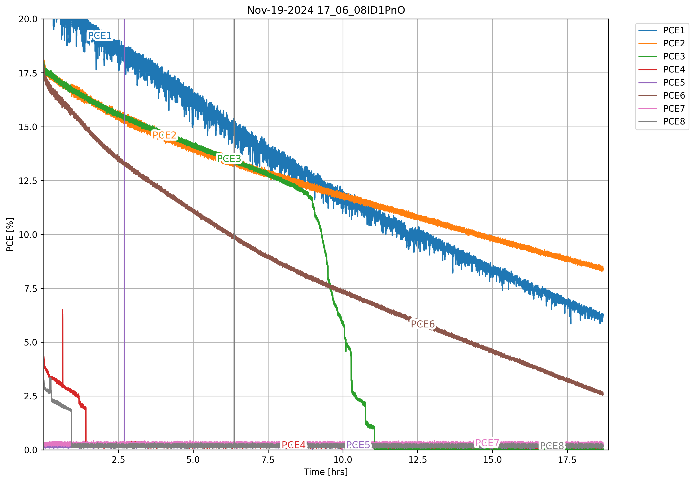
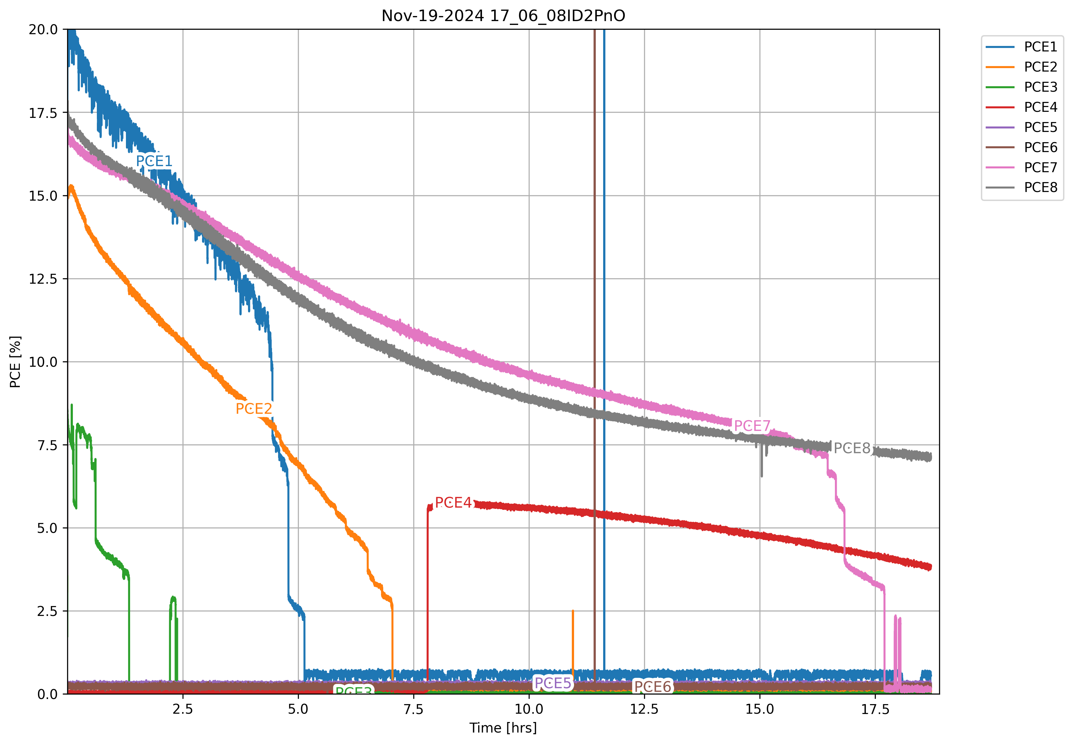
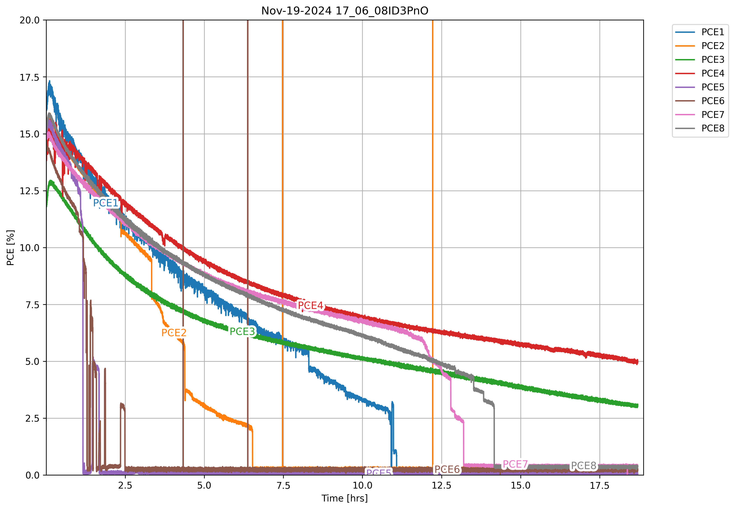

Slide 14
Future Works
Hardware:
Incorporate light control
Redesign PCB board
Use either ESP32 or Arduino Mini to reduce overall footprint, currently need external Arduino
Software:
Better user interface using electron
Live data updates
Interactive Graphs
Remote Access?
Measurement improvements
Scan rate parameter is currently broken
Lots of small bugs to fix

